Slide 1



Welcome you all
Course: CSS
Day 3 (Session 1)
CSS BOXMODEL
R.SUREKHA
Technical Trainer,
KG Micro College
KGiSL Campus, Coimbatore – 641 035.

Slide 2
What is Box Model?
Every element that can be displayed on a web page is comprised of one or more rectangular boxes. CSS box model typically describes how these rectangular boxes are laid out on a web page. These boxes can have different properties and can interact with each other in different ways, but every box has a content area and optional surrounding padding, border, and margin areas.
Why is CSS box model used?
The CSS Box Model is used to create a definition for the way the HTML elements are organized on the screen. This approach accounts for options such as margins, padding, borders, and all the properties that manipulate them. Each element can be thought of as having its own box.

Slide 3
CSS BOX MODEL
The CSS box model is the concept that describes the rectangular boxes that are generated for elements in the document tree and laid out according to the visual formatting model. Every HTML element is a rectangular box, and the CSS box model describes the layout of these boxes, including their dimensions and the space between them.
The Box Model is one of those core concepts, and we will explore each of the different elements to better understand how it works and help you be as efficient as possible when styling CSS.
In CSS, the term "box model" is used when talking about design and layout. The CSS box model is essentially a box that wraps around every HTML element. It consists of: margins, borders, padding, and the actual content.

Slide 4
The CSS box model consists of four parts:
The content:
This is the area where the element's content (e.g., text, images, etc.) is displayed.
The padding:
is the space between the content and the border.
The border:
This is the line that surrounds the padding and content.
The margin:
This is the space outside of the border.
When calculating the size and position of an element, the browser takes into account the width and height of the content, as well as the padding, border, and margin.

Slide 5
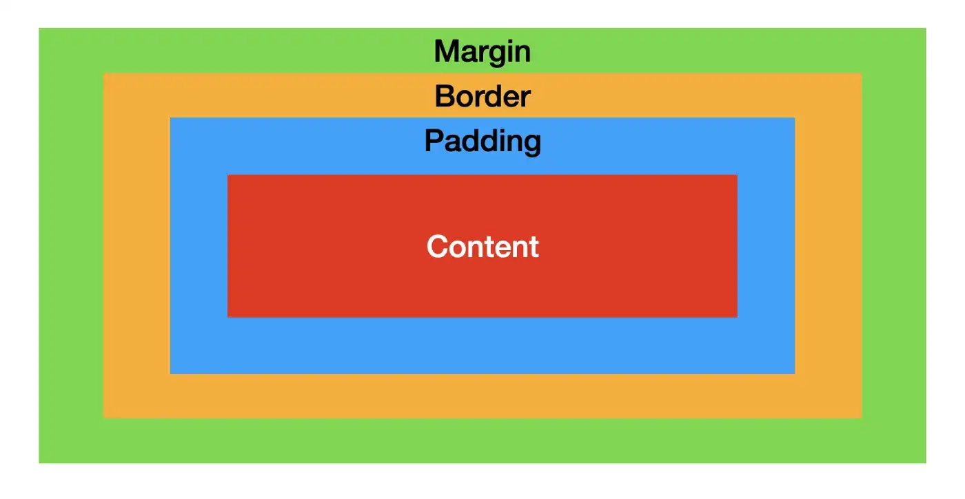

Slide 6
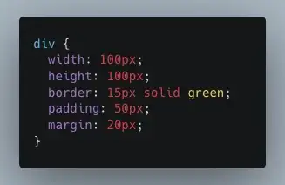
The CSS Box Model
The CSS box model is essentially a box that wraps around every HTML element. It consists of: - Content (images, text, etc.) - Padding - Border - Margin

Slide 7
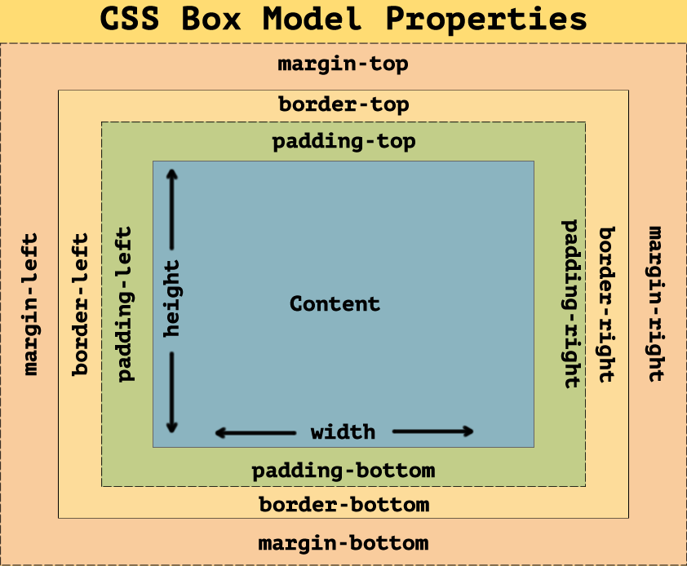

Slide 8
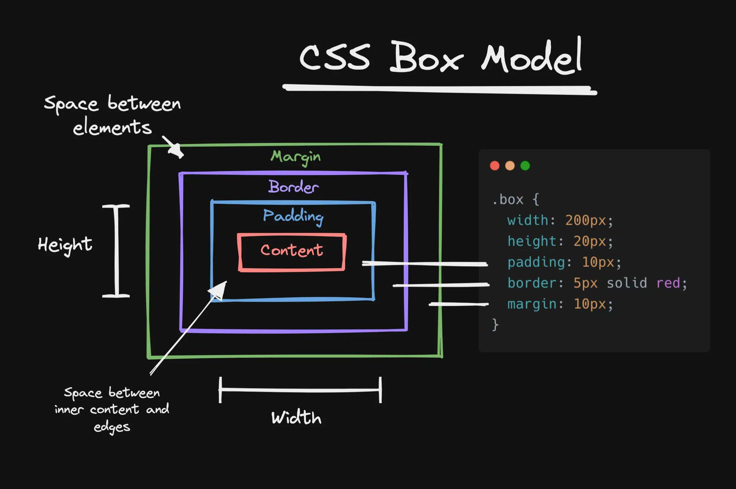

Slide 9
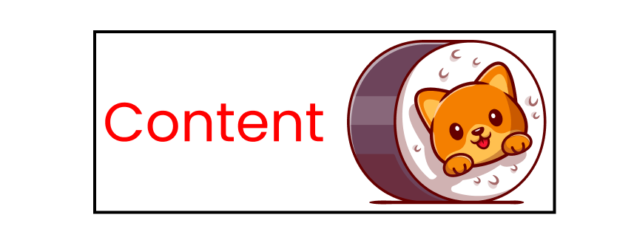
1st box-model layer: Content
In HTML, everything behaves like a box. Let's insert some content with a kitty image. 👇
1st layer of the box model: content

Slide 10
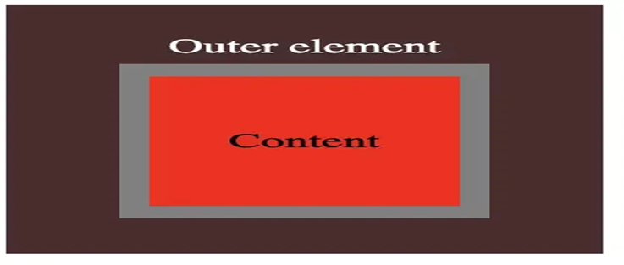
The height and width can be set specifically in CSS or it will be whatever the size of your content is. Your content is the main focus of the HTML element and can be text, images, links, etc.
PADDING
Padding is the space around your content.
The Padding Property
But first, let's discuss the practical uses of the padding property. Then, we'll see how to use this property.
Generally, I use padding to put some space between contents. Look at this navbar 👇

Slide 11
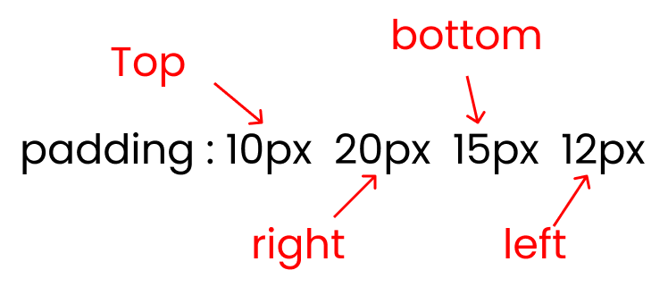
How to use the padding property in CSS
This is the shorthand of the four padding properties:
padding-top
padding-right
padding-bottom
padding-left

Slide 12
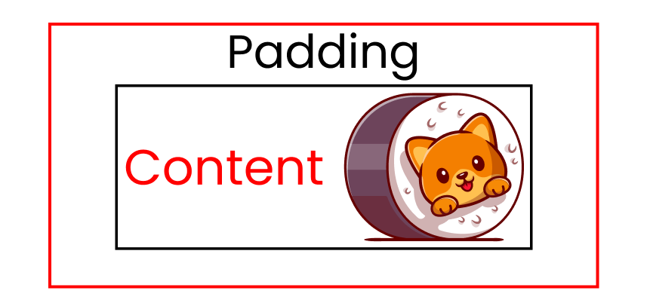
2nd box-model layer: Padding
The next layer of the CSS box model is the padding layer. It wraps our content like this 👇
2nd layer of the box model: padding

Slide 13
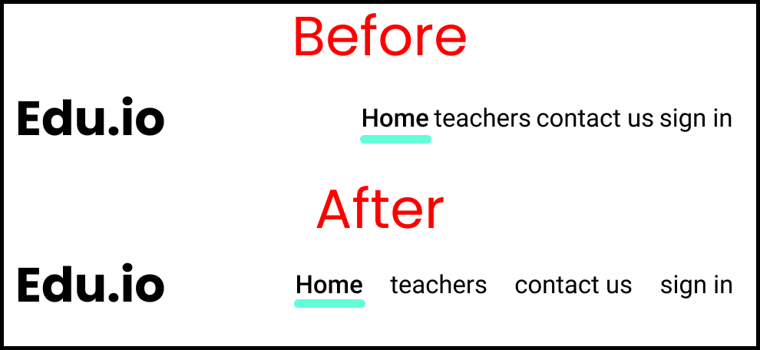
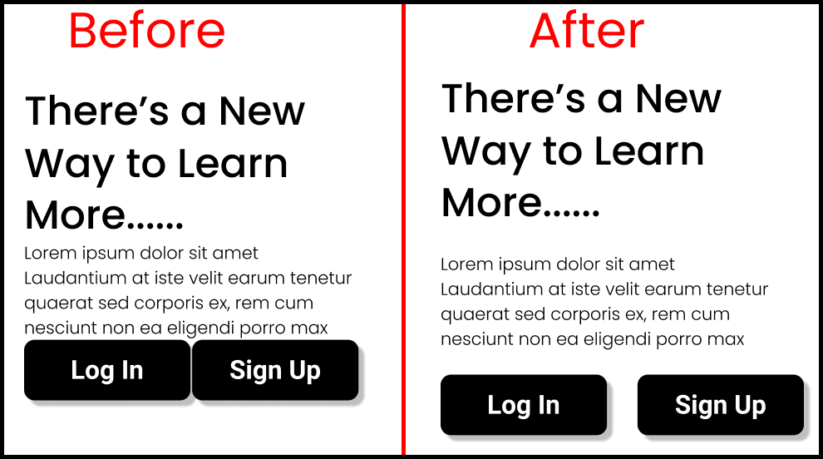

Slide 14
CSS Border
CSS Border Properties
The CSS border properties allow you to define the border area of an element's box.
Borders appear directly between the margin and padding of an element. The border can either be a predefined style like, solid line, dotted line, double line, etc. or an image.
The following section describes how to set the style, color, and width of the border.

Slide 15
BORDER
CSS border properties allow you to control the appearance of an element's border. Some of the most commonly used border properties include:
border-width: sets the width of the border.
border-style: sets the style of the border. Possible values include solid, dotted, dashed, double, and groove, among others.
border-color: sets the color of the border.
border-radius: sets the radius of the border's corners.
border-collapse: sets whether the table borders should be collapsed into a single border or separated.
border-spacing: sets the spacing between the cells in a table.
You can also use the shorthand property border to set all of the above properties at once, in the order: width, style, color.
You can apply these properties to any HTML element and make it look more attractive and user-friendly.

Slide 16
Understanding the Different Border Styles
The border-style property sets the style of a box's border such as: solid, dotted, etc. It is a shorthand property for setting the line style for all four sides of the elements border.
The border-style property can have the following values: none, hidden, solid, dashed, dotted, double, inset, outset, groove, and ridge. Now, let's take a look at the following illustration, it gives you a sense of the differences between the border style types.
h1 {
border-style: dotted;
}
p {
border-style: ridge;
}

Slide 17
BORDER SHORT HAND PROPERTY
When using the border property, the values for each of the individual properties should be specified in the order: width, style, color. For example:
border: 2px solid pink;
You can also use the border property to set the border on specific sides of an element, by using the following properties: border-top, border-right, border-bottom, border-left. For example:
border-top: 2px solid brown;
border-right: 3px dotted orange;
border-bottom: 4px dashed green;
border-left: 5px solid purple;

Slide 18
border-collapse: sets whether the table borders should be collapsed into a single border or separated.
border-spacing: sets the spacing between the cells in a table.
border-image: sets an image as the border of an element.
You can also set the border property on individual sides of an element using the following properties:
border-top
border-right
border-bottom
border-left
border-top-left-radius,
border-top-right-radius,
border-bottom-left-radius,
border-bottom-right-radius.

Slide 19
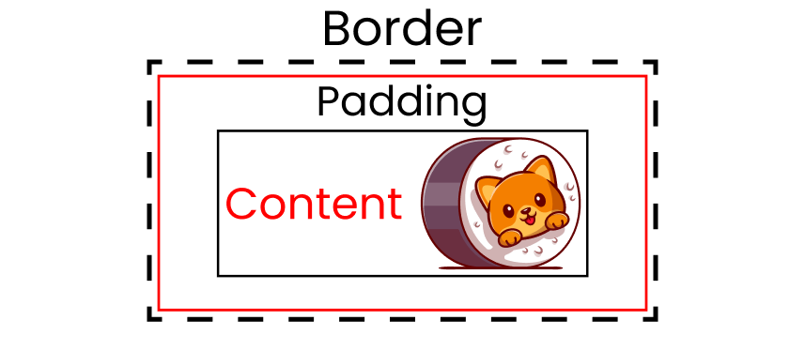
How to use the border property in CSS
And remember, the border is the space added on top of our main content + padding: 👇
The black dashed line is the border

Slide 20
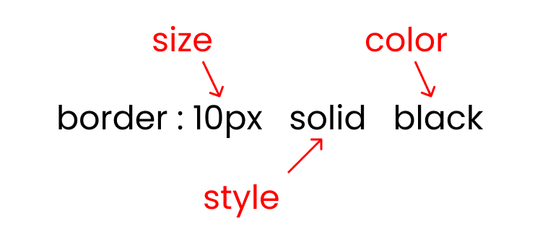
There are three crucial inputs of the border property:
border size
border style : solid / dotted/ dashed
border color
Border property syntax

Slide 21
Setting the Border Width
The border-width property specifies the width of the border area. It is a shorthand property for setting the thickness of all the four sides of an element's border at the same time.
p { border-style: dashed; border-width: 10px; }
Specifying the Border Color
The border-color property specifies the color of the border area. This is also a shorthand property for setting the color of all the four sides of an element's border.
p { border-style: solid; border-color:blue; }

Slide 22
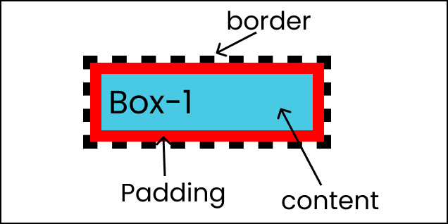

Slide 23
CSS Margin Properties
The CSS margin properties allow you to set the spacing around the border of an element's box (or the edge of the element's box, if it has no defined border).
Setting Margins for Individual Sides
You can specify the margins for the individual sides of an element such as top, right, bottom, and left sides using the CSS margin-top, margin-right, margin-bottom, and the margin-left properties, respectively.

Slide 24
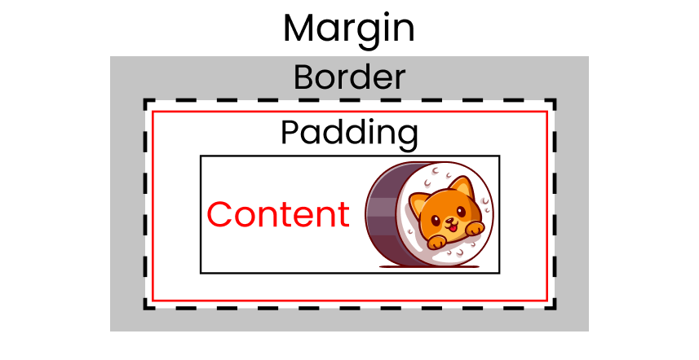
4th box-model layer: Margin
The next and final layer of the CSS box model is the margin layer. It wraps our content + padding + border like this 👇
And remember, margin is the space added on top of our main content + padding + border:

Slide 25
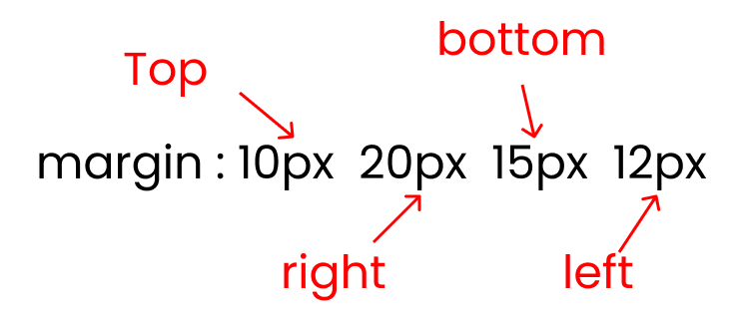
How to use margin property in CSS
This is the shorthand for the four properties of the margin property:
margin-top
margin-right
margin-bottom
margin-left

Slide 26
The margin property in CSS is used to specify the space outside of an element's border. It allows you to create space between elements and control the layout of your webpage.
You can set the margin property on all four sides of an element using the following properties:
margin-top: sets the margin on the top of the element
margin-right: sets the margin on the right of the element
margin-bottom: sets the margin on the bottom of the element
margin-left: sets the margin on the left of the element
The margin property takes a value, which can be a length (such as pixels), a percentage, or one of the following keywords: auto, inherit, or initial.
auto: The browser will automatically calculate the margin. This is often used to center elements horizontally.
inherit: The margin will inherit the value from the parent element.
initial: The default value of the property will be used.

Slide 27
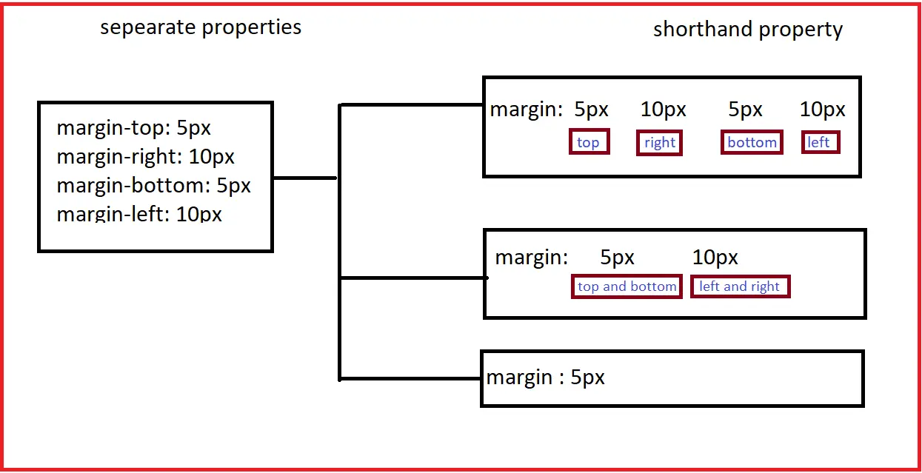

Slide 28
The Margin Shorthand Property
The margin property is a shorthand property to avoid setting margin of each side separately, i.e., margin-top, margin-right, margin-bottom and margin-left.
h1 { margin: 50px; /* apply to all four sides */ } p { margin: 25px 75px; /* vertical | horizontal */ } div { margin: 25px 50px 75px; /* top | horizontal | bottom */ } hr { margin: 25px 50px 75px 100px; /* top | right | bottom | left */ }

Slide 29
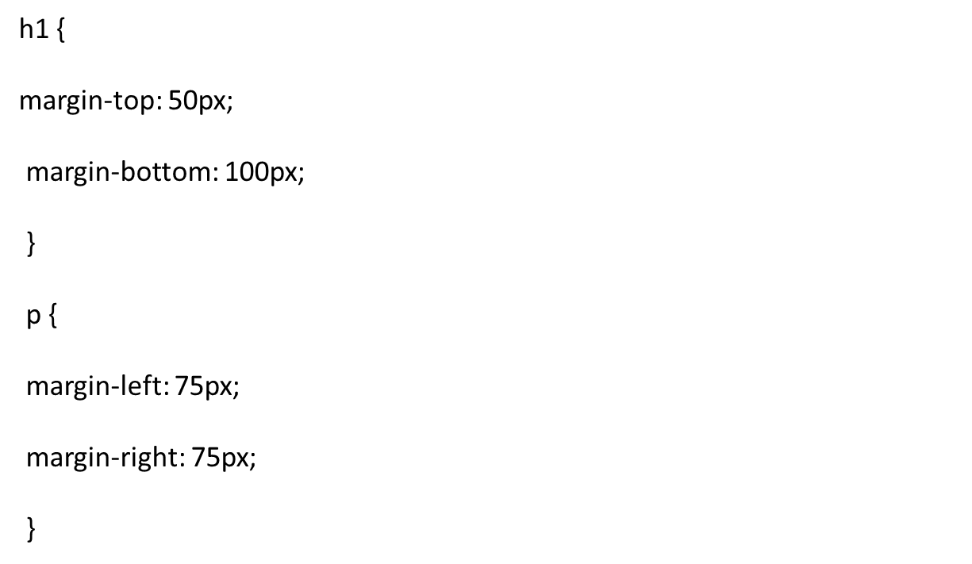

Slide 30
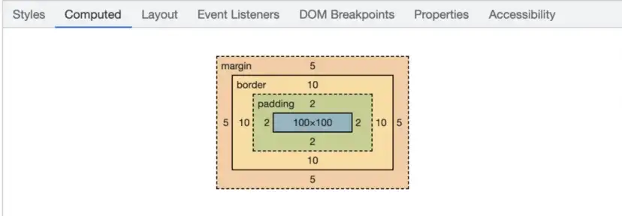
Calculating Total Width or Height
When calculating the total width or height of an element, you simply need to add together the margin, border, padding, and content sizes.
margin top + margin bottom+ border top + border bottom + padding top + padding bottom + content height= total height
margin left + margin right+ border left + border right + padding left + padding right + content width= total width
When using the developer tools in your browser, this will be calculated for you and you can see how the different values break down.

Slide 31
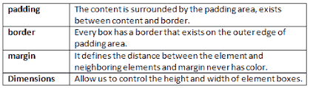

Slide 32
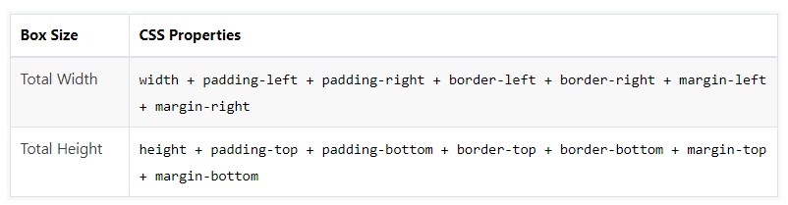
Width and Height of the Elements
Usually when you set the width and height of an element using the CSS width and height properties, in reality you are only setting the width and height of the content area of that element. The actual width and height of the element's box depends on the several factors.

Slide 33
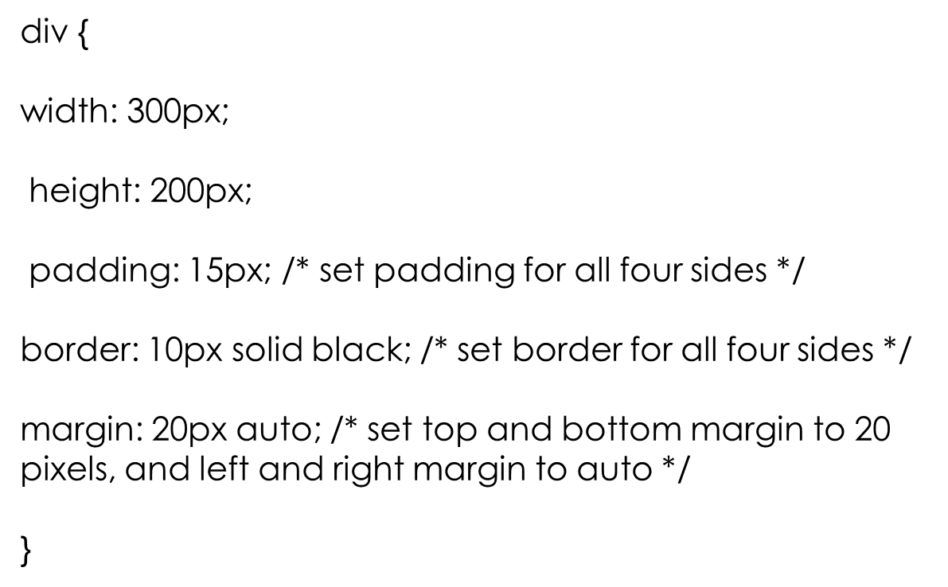

Slide 34
CSS Dimension
Setting Element Dimensions
CSS has several dimension properties, such as width, heigght, max-width, min-width, max-height, and min-height that allows you to control the width and height of an element. The following sections describe how to use these properties to create a better web page layout.

Slide 35
Setting the Width and Height
The width and height property defines the width and height of the content area of an element.
This width and height does not include paddings, borders, or margins. See the CSS box model to know how the effective width and height of an element's box is calculated.
div {
width: 300px; height: 200px;
}

Slide 36
The width and height properties can take the following values:
length - specifies a width in px, em, rem, pt, cm, etc.
% - specifies a width in percentage (%) of the width of the containing element.
auto - the browser calculates a suitable width for the element.
initial - Sets the width and height to its default value, which is auto.
inherit - specifies that the width should be inherited from the parent element.

Slide 37
Setting Maximum Width and Height
You can use the max-width and max-height property to specify the maximum width and height of the content area. This maximum width and height does not include paddings, borders, or margins.
div {
width: 300px;
max-width: 200px;
}

Slide 38
Setting Minimum Width and Height
You can use the min-width and min-height property specify the minimum width and height of the content area. This minimum width and height does not include paddings, borders, or margins.
div {
width: 200px;
min-width: 300px;
}

Slide 39
Horizontal Centering with Auto Margins
The auto value for the margin property tells the web browser to automatically calculate the margin. This is commonly used to center an element horizontally within a larger container.
div {
width: 300px;
background color: green;
margin: 0 auto;
}

Slide 40



Thank You

